Slide 1

DATA SCIENCE AND MACHINE LEARNING BOOTCAMP
SQL

Slide 2
SQL
SQL is the single most requested language for positions of Data Analyst and Data Scientist. Ahead of Python, ahead of R, ahead of Excel.
Why do you think that is?

Slide 3
SQL
Structured Query Language is a standard database language used to create, manage and query data from relational databases.
We need to clarify some of these words today
Database
Relational
Query

Slide 4
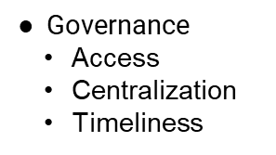
DATABASES
Organized collection of data structured in ways that impose some rules on the data according to needs, e.g.
Size
Accuracy
Security
Redundancy
Accessibility

Slide 5
ANATOMY OF A DATABASE
ALL THE COMPONENTS WE WILL TALK ABOUT
Tables
Columns
Rows
Keys
Relationships
Views
Data Squad | SQL

Slide 6
TABLES, COLUMNS, ROWS
TABLES
Tables are the main structures in the database.
Each table always represents a single, specific subject. The order of rows and columns within a table is of absolutely no importance. Every table should contain at least one column—known as a primary key—that uniquely identifies each of its rows.
The subject that a given table represents is usually either an object or an event. When the subject is an object, the table represents something that is tangible, such as a person, place, or thing. (i.e.: Pilots, products, machines, students, buildings, and equipment ) When the subject is an event, the table represents something that occurs at a given point in time and has characteristics you wish to record. (i.e.: judicial hearings, distributions of funds, lab test results, and geological surveys )

Slide 7
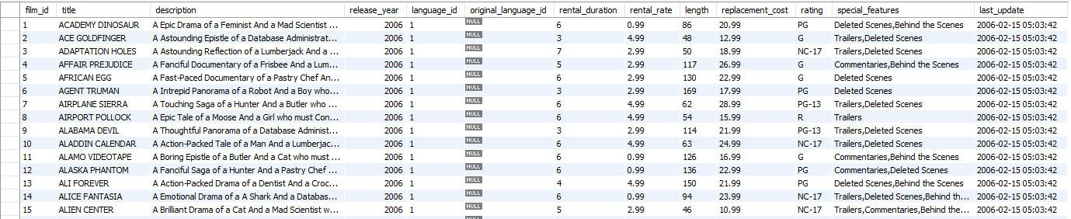
Data Squad | SQL
SAMPLE - SAKILA DATABASE
THE FILMS TABLE

Slide 8
COLUMNS - ATTRIBUTES OF THE OBJECT
Columns represent a characteristic of the subject of the table to which it belongs.
Columns are the structures that store data. You can retrieve the data in these columns and then present it as information in almost any configuration imaginable.
ROWS - ENTRIES OF THE OBJECT
A row represents a unique instance of the subject of a table. It is composed of the entire set of columns in a table, regardless of whether or not the columns contain any values.
Data Squad | SQL

Slide 9
DATA TYPES
WHAT TYPES CAN THE SINGLE PIECE OF DATA BE?
- Integers (smallint, int, bigint)
- Serial (autoincrementing: smallserial, serial, bigserial)
- Char
- Fixed/floating point (numeric real double precision)
- Varchar (variable length char)
- Text (unlimited length)
-Date (timestamp, date, time, interval)

Slide 10
Data Squad | SQL
SAMPLE - SAKILA DATABASE
THE FILMS TABLE

Slide 11
TYPES OF DATABASES OPERATIONAL VS ANALYTICAL
Operational databases are the backbone of many companies, organizations, and institutions throughout the world today. This type of database is primarily used to collect, modify, and maintain data on a day-to-day basis. The type of data stored is dynamic, meaning that it changes constantly and always reflects up-to-the-minute information.
Analytical databases store and track historical and time-dependent data. They are valuable assets for tracking trends, viewing statistical data over a long period, or making tactical or strategic business projections. The type of data stored is static, meaning that the data is never (or very rarely) modified, although new data might often be added.

Slide 12
WHAT IS A RELATIONAL DATABASE
Data Squad | SQL
A relational database is a database structured to recognise relations between stored items of information.
Relational databases are built of tables, which establish the relation between tuples (records or rows) and attributes (fields or columns).
Each table can be related to each other using the concepts of keys

Slide 13
RDBMS
A relational database management system (RDBMS) is a software application program you use to create, maintain, modify, and manipulate a relational database.
SQL is the de facto universal language to work with data from relational databases so naturally, most RDBMS support SQL. SQL is more than just a means for extracting knowledge from data. It’s also a language for defining the structures that hold data so we can organize relationships in the data.
MySQL is one of many RDBMS that support the use of SQL. We will use a graphical user interface to
work with MySQL called MySQL workbench.

Slide 14
SHOW CASE SAKILLA

Slide 15
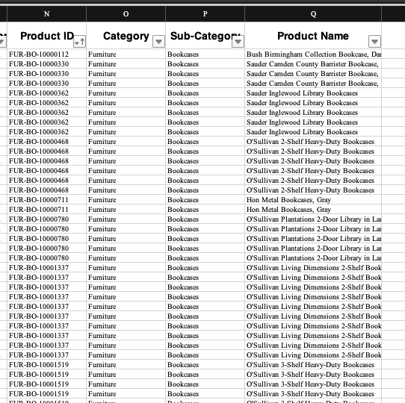
DATABASE ORGANIZATION
We are used to seeing denormalized tables.
Easier to read but a lot of data replicated
What if we transformed it into a link between two tables?

Slide 16
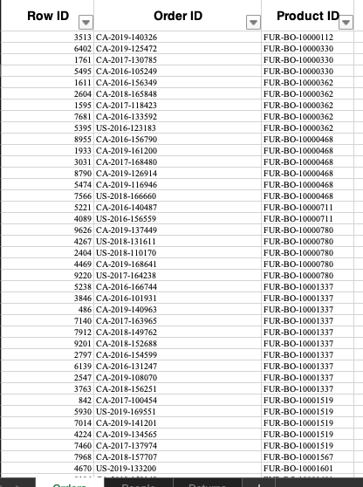
DATABASE ORGANIZATION
In one, you would see the products in each order

Slide 17
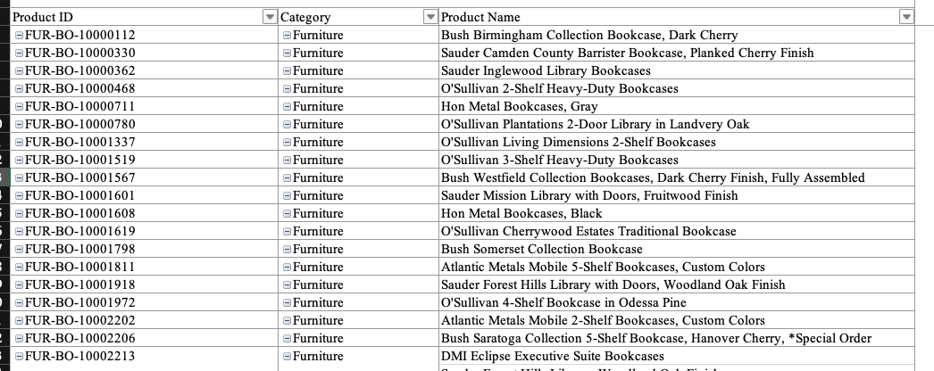
DATABASE ORGANIZATION
In the other, each line is a product, and there is no product repetition

Slide 18
DATABASE ORGANIZATION
Now, do you want to know the Name of the product based on the order ID?

Slide 19
DATABASE ORGANIZATION
These are called Normalized tables and can be “blend” together to obtains the data via de join operation
JOIN

Slide 20
RELATIONSHIPS
RELATIONSHIPS BETWEEN OBJECTS\TABLES
If rows in a given table can be associated in some way with rows in another table, the tables are said to have a relationship between them.
There are three types of relationships:
1 to 1
1 to many
many to many
Keys are a special table construct designed to denote relationships between tables

Slide 21
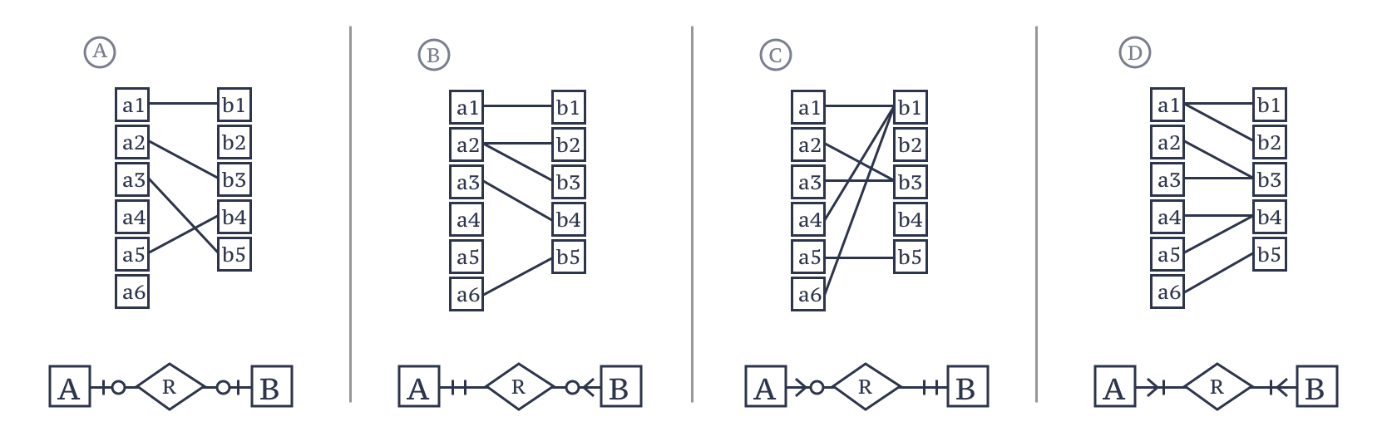
POSSIBLE RELATIONSHIPS BETWEEN TABLES
People to Tax numbers
Directors to films
Films to Directors
Actors to films
one-to-one
one-to-many
many-to-one
many-to-many
Join does not cause duplicates
Join causes duplicates of A
Join causes duplicates of B
Join causes duplicates of A and of B
Optional relation causes losses of A in Inner joins and Right joins
Mandatory relation prevents losses of A in Inner joins and Right joins

Slide 22



QUERIES – Scripting vs QUERYING
Lets say we want to build a HotDog

Slide 23



QUERIES – Scripting vs QUERYING
SCRIPTING

Slide 24
QUERIES – Scripting vs QUERYING
SCRIPTING
pd.read_csv()
pd.groupby()
pd.filtering
etc

Slide 25



QUERIES – Scripting vs QUERYING
QUERYING
I want a hotdog with mustard

Slide 26
QUERIES – Scripting vs QUERYING
QUERYING
groupby()
filtering
I want data in a specific way

Slide 27
QUERIES I
Retrieving information from the database
You have to specify which table(s) you want information for
What is the criteria for the rows to be returned? any filters?
How to manipulate the resulting fields?

Slide 28
SELECT STATEMENT
SELECT * FROM sakila.film;
SELECT title, description, rating FROM sakila.film; SELECT DISTINCT rental_duration
FROM sakila.film;
SELECT DISTINCT rental_duration, language_id FROM sakila.film;

Slide 29
ORDER BY
Data Squad | SQL
SELECT title, rental_rate, length FROM sakila.film
ORDER BY length DESC;
SELECT title, rental_rate, length FROM sakila.film
ORDER BY length DESC, rental_rate DESC;

Slide 30
ALIASING and COMPUTATIONS
SELECT title, rental_rate AS cost, length FROM sakila.film;
SELECT title, rental_rate/length AS price_per_min FROM sakila.film
ORDER BY price_per_min ASC
SELECT CONCAT(title,', rating:',rating) AS descriptor FROM sakila.film;
https://www.w3schools.com/sql/sql_ref_sqlserver.asp

Slide 31
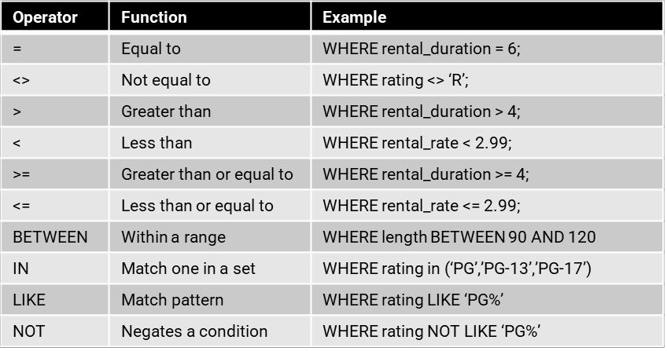
WHERE - HOW TO RETRIEVE DATA FROM SPECIFIC ROWS
SELECT *
FROM sakila.film
WHERE rental_duration = 6;

Slide 32
AGGREGATIONS AND GROUP BY
SELECT COUNT(*),MAX(rental_duration),AVG(replacement_cost),AVG(rental_duration) FROM sakila.film
SELECT rating, COUNT(rating), AVG(rental_rate) FROM sakila.film
GROUP BY rating;
SELECT rating, rental_duration, COUNT(rating), AVG(rental_rate) FROM sakila.film
GROUP BY rating, rental_duration;

Slide 33
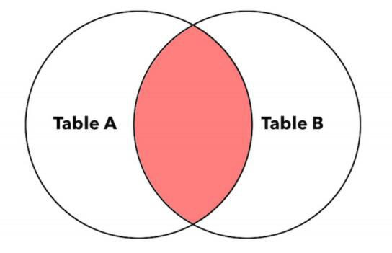
INNER JOIN
RETURNS ROWS FROM BOTH TABLES WHERE MATCHING VALUES ARE FOUND IN THE JOINED COLUMNS OF BOTH TABLES.
SELECT *
FROM Table_A INNER JOIN Table_B
ON Table_A.Key = Table_B.Key
SELECT world.country.Name AS Country_Name, world.city.Name AS City_Name, world.country.GNP/world.city.Population AS GNP_per_capita
FROM world.country INNER JOIN world.city
ON world.country.Code = world.city.CountryCode;

Slide 34
KEYS
PRIMARY VS FOREIGN
Every table in your database should have a primary key. A primary key consists of one column that uniquely identifies each row within a table.
The primary key:
identifies a specific row throughout the entire database,
its column identifies a given table throughout the entire database.
enforce table-level integrity and help establish relationships with other tables.
When you determine that a pair of tables has a relationship to each other, you typically establish the relationship by taking a copy of the primary key from the first table and inserting it into the
second table, where it becomes a foreign key.

Slide 35
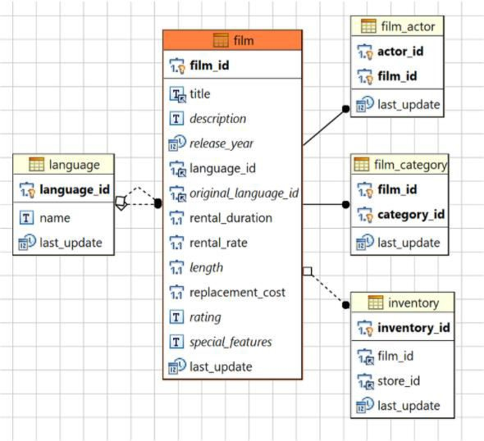
RELATIONAL DATABASE SCHEMAS
Entity Relational Diagram (ERD)
Shows content of each table and connections between tables within a database schema
Primary Key and Foreign Key visual here

Slide 36
ONE-TO-ONE RELATIONSHIP
A SINGLE ROW IN THE FIRST TABLE IS RELATED TO ONLY ONE ROW IN THE SECOND TABLE
A pair of tables has a one-to-one relationship when a single row in the first table is related to only one row in the second table, and a single row in the second table is related to only one row in the first table.
In this type of relationship, one table is referred to as the primary table, and the other is referred to as the secondary table. You establish this relationship by taking the primary key of the primary table and inserting it into the secondary table, where it becomes a foreign key. This is a special type of relationship because in nearly all cases the foreign key also acts as the primary key of the secondary table.
(e.g. citizen id and passport nr. Notice not all citizens have a passport)

Slide 37
ONE-TO-MANY RELATIONSHIP
ONE ROW IN ONE TABLE HAS A RELATIONSHIP WITH MULTIPLE ROWS IN ANOTHER TABLE
When a pair of tables has a one-to-many relationship, a single row in the first table can be related to many rows in the second table, but a single row in the second table can be related to only one row in the first table.
This relationship is established by taking the primary key of the table on the “one” side and inserting it into the table on the “many” side, where it becomes a foreign key. In this case the second table has also its own primary key.
(e.g. city and country - world database)

Slide 38
MANY-TO-MANY RELATIONSHIP
MANY ROWS IN ONE TABLE HAVE A RELATIONSHIP WITH MULTIPLE ROWS IN ANOTHER TABLE
A pair of tables is in a many-to-many relationship when a single row in the first table can be related to many rows in the second table, and a single row in the second table can be related to many rows in the first table.
To establish this relationship properly, you typically create what is known as a linking table. This table provides an easy way to associate rows from one table with those of the other and will help to ensure that you have no problems adding, deleting, or modifying any related data. You define a linking table by taking a copy of the primary key of each table in the relationship and using them to form the structure of the new table. These columns actually serve two distinct roles: Together they form the composite primary key of the linking table, and separately they each serve as a foreign key.
(e.g. actor and film - sakila)

Slide 39
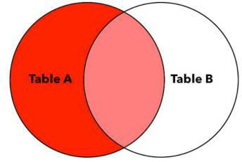
LEFT JOIN
Data Squad | SQL
RETURNS EVERY ROW FROM THE LEFT TABLE PLUS ROWS THAT MATCH VALUES IN THE JOINED COLUMN FROM THE RIGHT TABLE.
SELECT *
FROM Table_A LEFT JOIN Table_B
ON Table_A.Key = Table_B.Key
If there’s no match for a value in the left table, the query result contains NULL values for the right table columns.

Slide 40
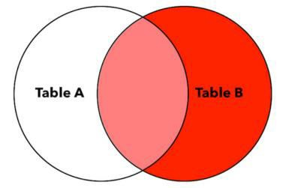
RIGHT JOIN
RETURNS EVERY ROW FROM THE RIGHT TABLE PLUS ROWS THAT MATCH THE KEY VALUES IN THE KEY COLUMN FROM THE LEFT TABLE
table columns.
SELECT *
FROM Table_A RIGHT JOIN Table_B
ON Table_A.Key = Table_B.Key
If there’s no match for a value in the right table, the query result contains NULL values for the left

Slide 41
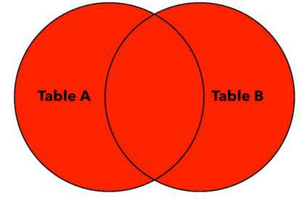
FULL OUTER JOIN
RETURNS EVERY ROW FROM BOTH TABLES AND MATCHES ROWS; THEN JOINS THE ROWS WHERE VALUES IN THE JOINED COLUMNS MATCH.
empty row for the other table.
SELECT *
FROM Table_A OUTER JOIN Table_B
ON Table_A.Key = Table_B.Key
If there’s no match for a value in either the left or right table, the query result contains an

Slide 42
END OF DAY 1

Slide 43
DATA SCIENCE AND MACHINE LEARNING BOOTCAMP
SQL – Day 2

Slide 44
SUBQUERIES
As the name implies, subqueries are queries nested inside another query.
You can use a subquery in the place of any table of the main query, since SELECT statements themselves return “tables”
This is often a solution used for quick analysis since subqueries can easily become very complex

Slide 45
SUBQUERIES
Example: find the names of the actors which starred in movies with lengths higher or equal to the average length of all the movies

Slide 46
SUBQUERIES
Example: find the names of the actors which starred in movies with lengths higher or equal to the average length of all the movies
SELECT AVG(length) AS average FROM films

Slide 47
SUBQUERIES
Example: find the names of the actors which starred in movies with lengths higher or equal to the average length of all the movies
SELECT *
FROM sakila.film
WHERE length > (SELECT AVG(length) AS average FROM film)

Slide 48
SUBQUERIES
Example: find the names of the actors which starred in movies with lengths higher or equal to the average length of all the movies
SELECT film_id FROM sakila.film
WHERE length > (SELECT AVG(length) AS average FROM film)

Slide 49
SUBQUERIES
Example: find the names of the actors which starred in movies with lengths higher or equal to the average length of all the movies
SELECT DISTINCT actor_id FROM sakila.film_actor
INNER JOIN
(SELECT film_id
FROM sakila.film
WHERE length > (SELECT AVG(length) AS average FROM film)) AS selected_films_id
ON sakila.film_actor.film_id = selected_films_id.film_id

Slide 50
SUBQUERIES
Example: find the names of the actors which starred in movies with lengths higher or equal to the average length of all the movies
SELECT first_name, last_name FROM sakila.actor
INNER JOIN (
SELECT DISTINCT actor_id FROM sakila.film_actor
INNER JOIN (SELECT film_id FROM sakila.film WHERE length > (SELECT AVG(length) AS average FROM
film)) AS selected_films_id
ON sakila.film_actor.film_id = selected_films_id.film_id) AS selected_actors ON sakila.actor.actor_id = selected_actors.actor_id

Slide 51
TEMPORARY
TABLES COMPLEXITY BREEDS ERROR
Subqueries can easily become very complex and therefore hard to debug and get wrong Temporary Tables can be reused and stored for a whole session
They are destroyed after the session, no actual database space is used

Slide 52
VIEWS
What if we would like to save a query?
DROP VIEW IF EXISTS actor_categories;
-- Create a new view
CREATE VIEW actor_categories AS
SELECT
actor_id,
first_name,
last_name,
COUNT(film_id) AS total_films,
CASE
WHEN COUNT(film_id) >= 30 THEN 'Star Actor'
WHEN COUNT(film_id) >= 15 THEN 'Frequent Actor'
ELSE 'Occasional Actor'
END AS actor_category
FROM
actor
JOIN
film_actor ON actor.actor_id = film_actor.actor_id
GROUP BY
actor_id
ORDER BY
total_films DESC;
SELECT `actor_categories`.`actor_id`,
`actor_categories`.`first_name`,
`actor_categories`.`last_name`,
`actor_categories`.`total_films`,
`actor_categories`.`actor_category`
FROM `sakila`.`actor_categories`;

Slide 53
ADVANCED TOPICS

Slide 54
ACTIONS QUERIES Action queries are queries that alter the database
CREATE DATABASE
CREATE TABLE
ALTER TABLE
INSERT INTO
UPDATE
DROP TABLE
DROP DATABASE

